Slide 1
Job Portal
Awais Tariq
Yasir Mukhtar

Slide 2
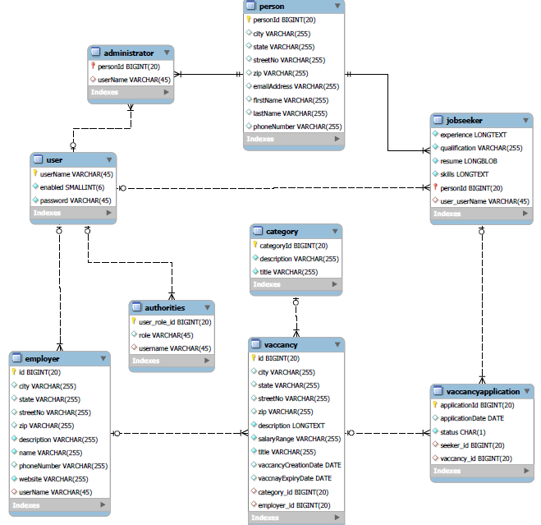
ERD<number>

Slide 3
DEMO

Slide 4
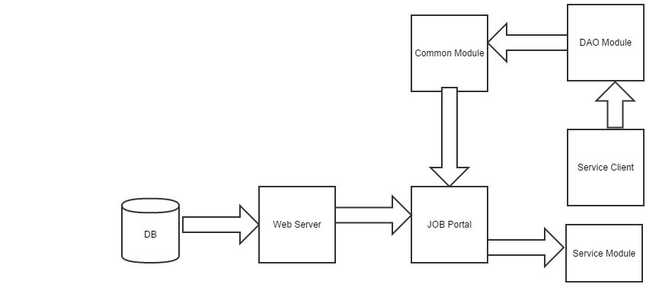
High Level Design

Slide 5
Features
SOC
Hibernate (Validation)
Spring MVC
Spring Security
AOP
Spring Mail Template
Apache Logging
File Uploading

